Slide 1
PHP
Chapter 19: PHP
By: Dr. Qusai Abuein

Slide 2
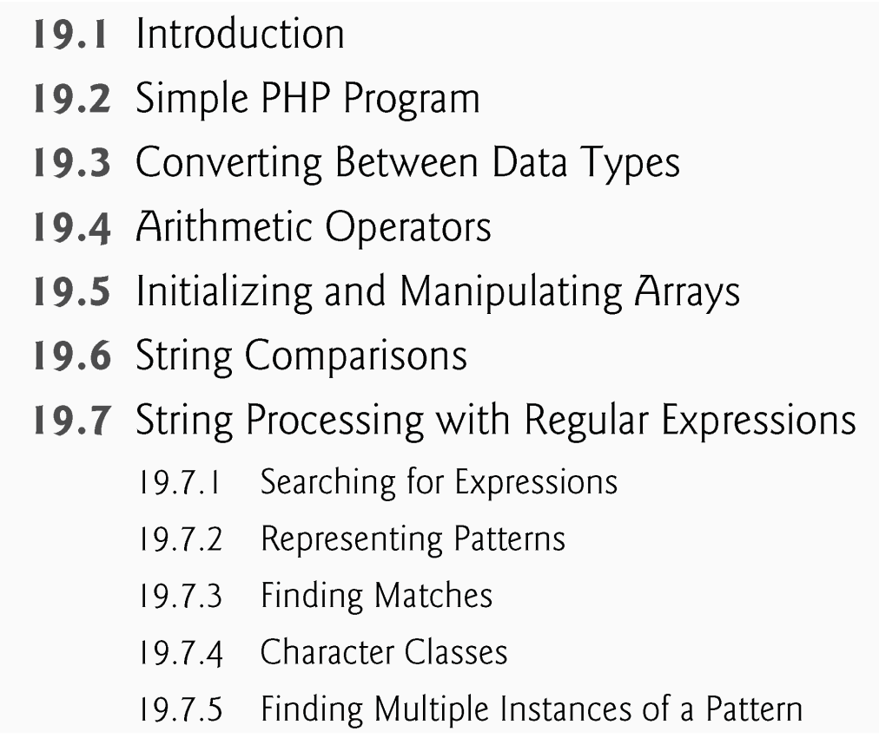
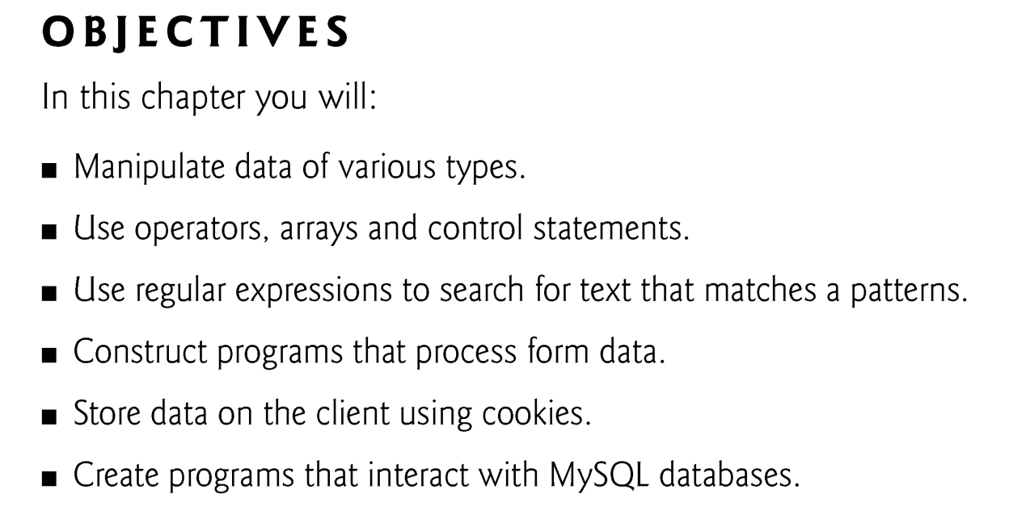
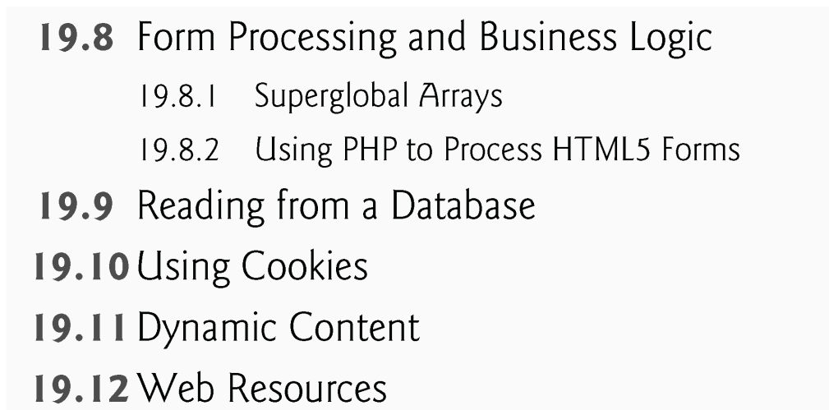

Slide 3
19.8 Form Processing and Business Logic
Superglobal arrays are associative arrays predefined by PHP that hold variables acquired from user input, the environment or the web server and are accessible in any variable scope.
The arrays $_GET and $_POST retrieve information sent to the server by HTTP get and post requests, respectively.

Slide 4
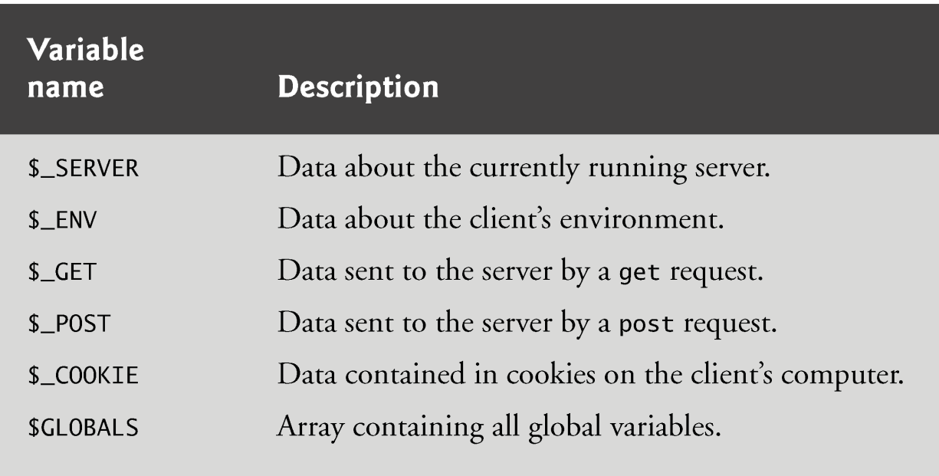

Slide 5
Form processing
action property
Where to send form data (php file)
method property
Post
Get
Each element has unique name

Slide 6
19.8.2 Using PHP to Process HTML5 Forms
Using method = "post" appends form data to the browser request that contains the protocol and the requested resource’s URL.
Scripts located on the web server’s machine can access the form data sent as part of the request.

Slide 7
19.4 Form Processing and Business Logic (Cont.)
We escape the normal meaning of a character in a string by preceding it with the backslash character (\).
Function die terminates script execution. The function’s optional argument is a string, which is printed as the script exits.

Slide 8
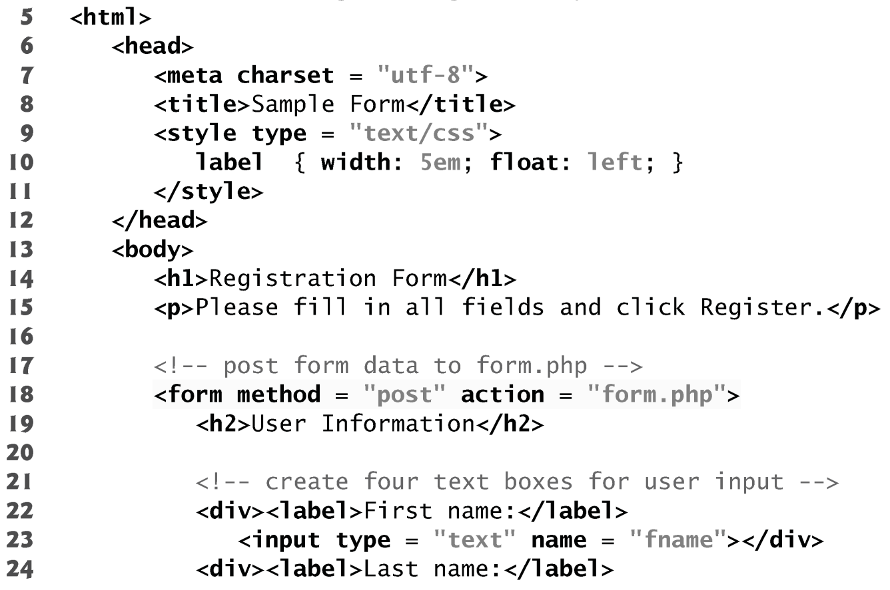

Slide 9
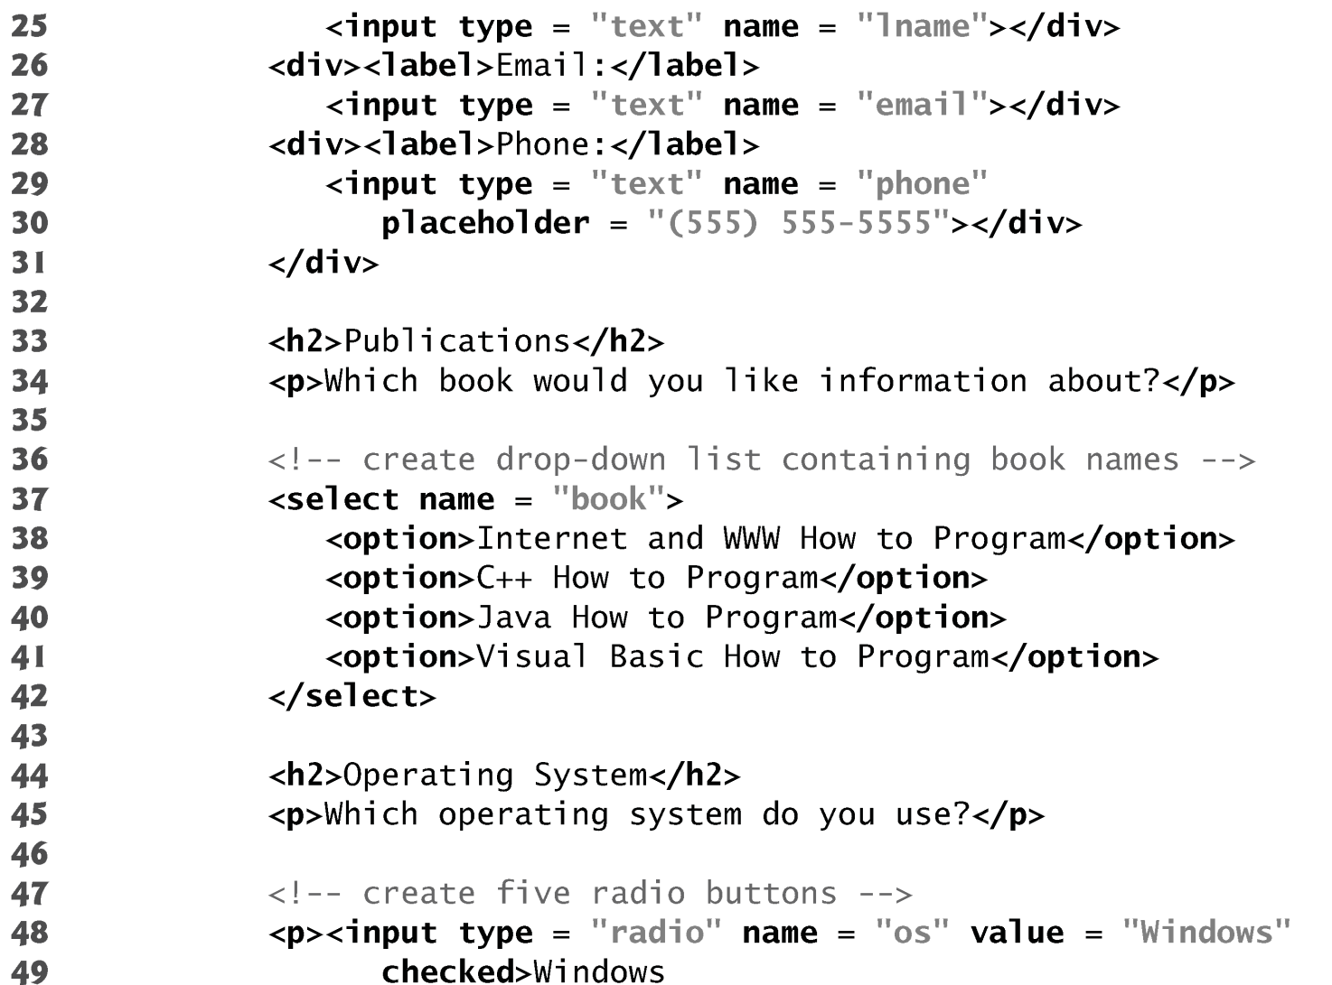
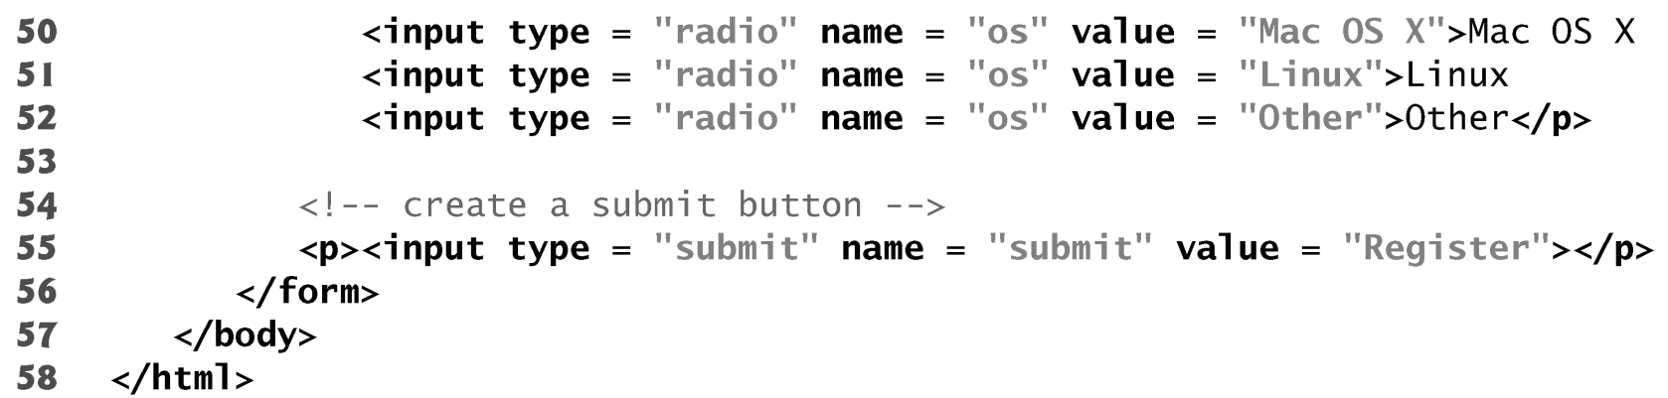

Slide 10
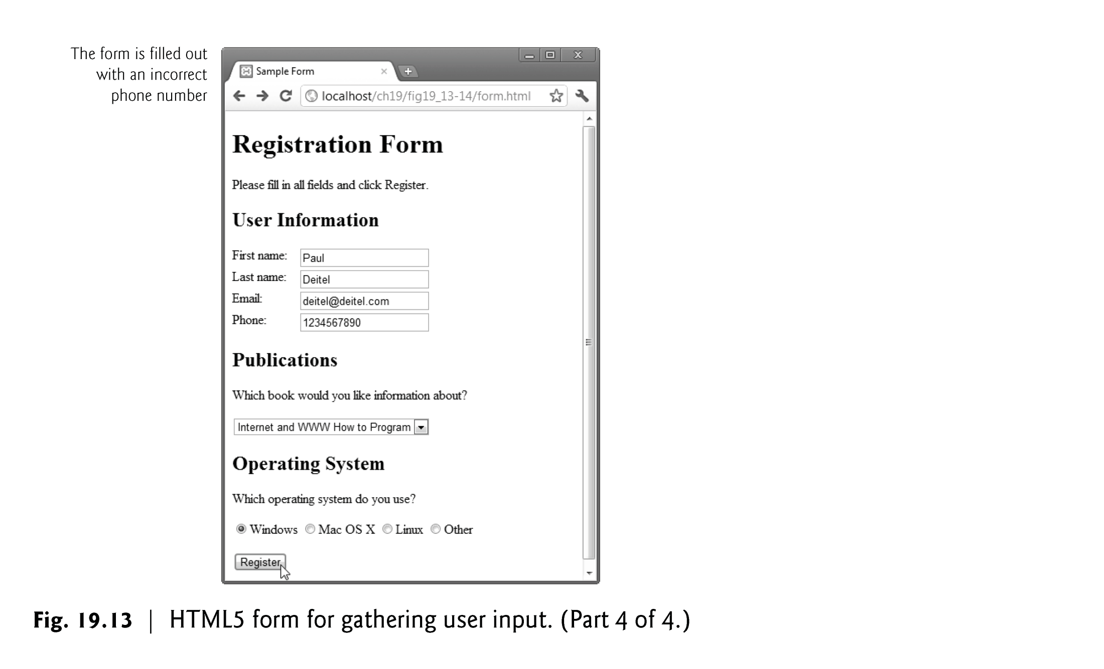

Slide 11
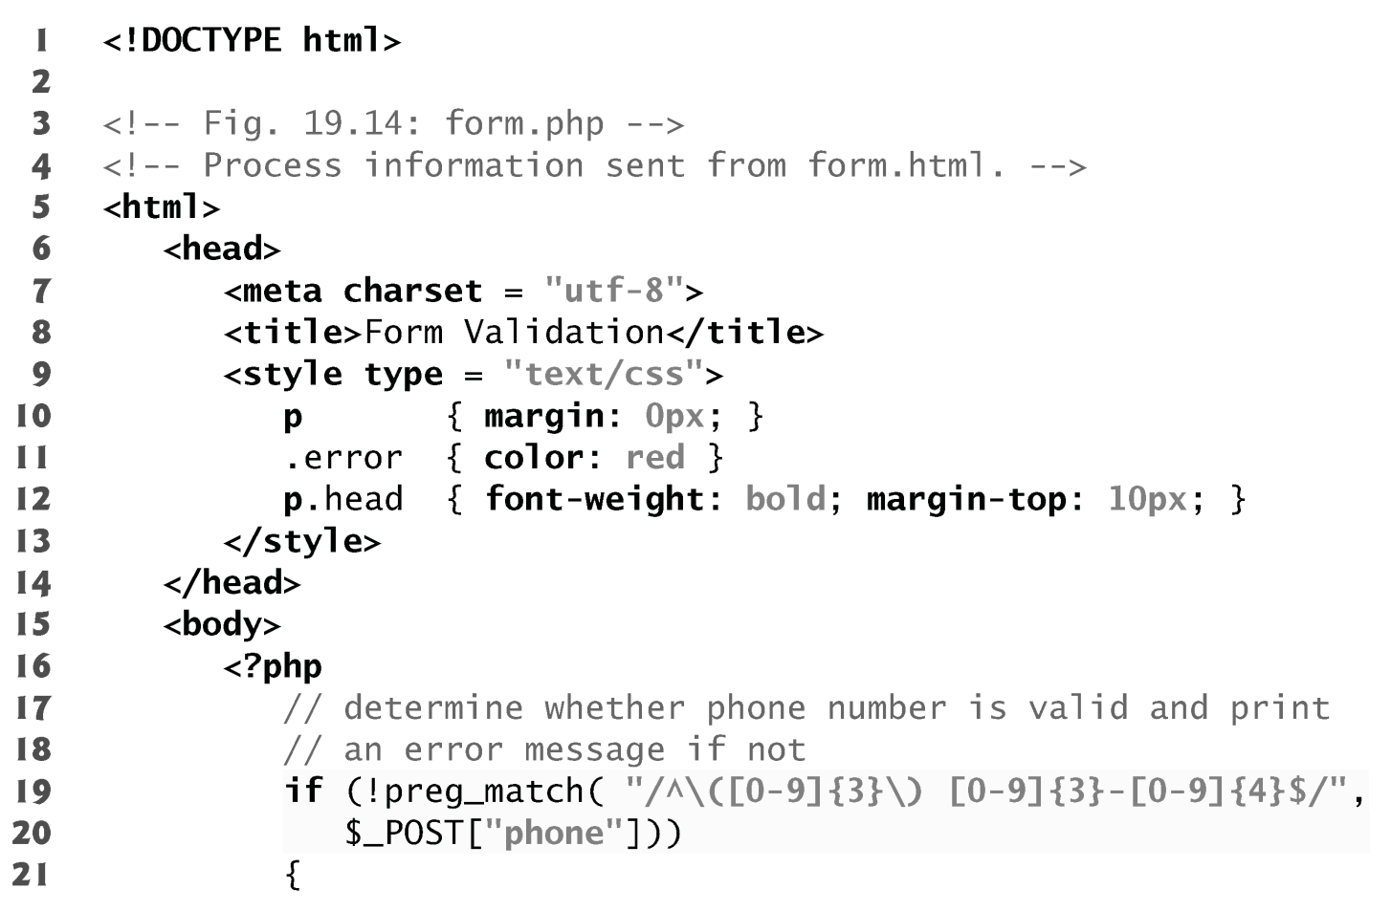

Slide 12
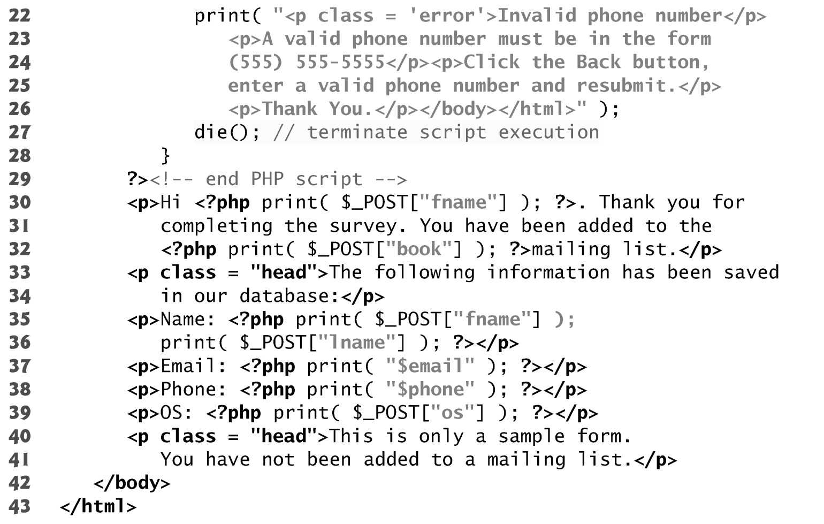

Slide 13
